Slide 1
NLP Project (Group 3)
Wong, Pak Wah
Vlasic, Gordon
Singh, Sunehildeep
Phan, Huyen Anh
Kuriakose, Rincy
Chan, Man Kit

Slide 2
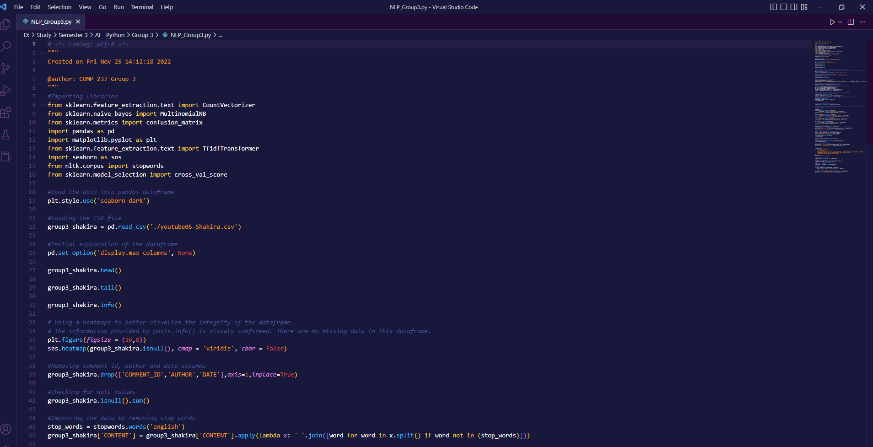
Code

Slide 3
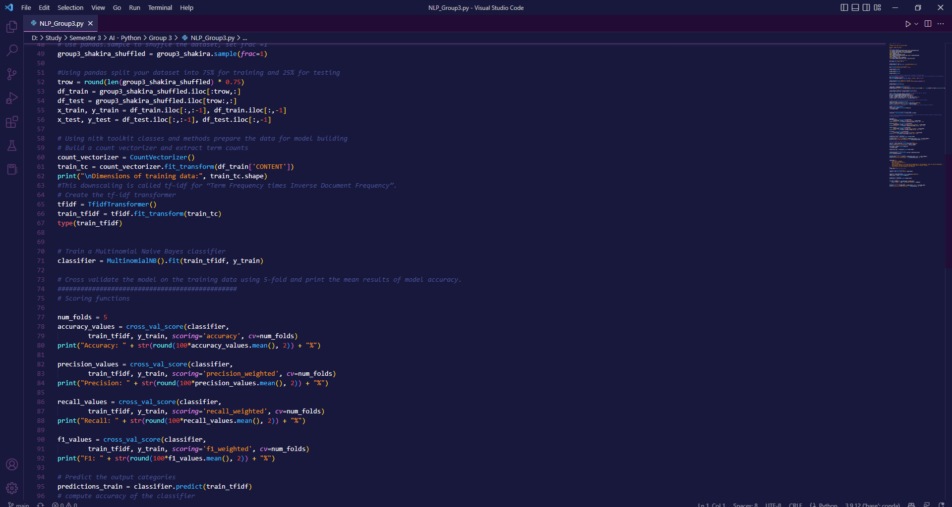
Code CONTD

Slide 4
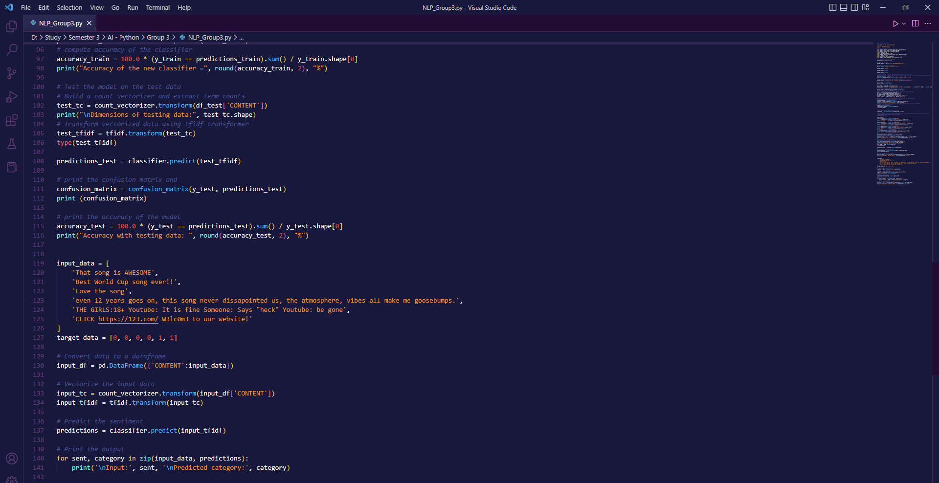
Comments we added

Slide 5
Our Comments
Our 4 real comments:
That song is AWESOME
Best World Cup song ever!!
Love the song
Even after 12 years, this song does not disappoint. The atmosphere, along with the vibes the song gives off, gives me goosebumps.
Our 2 fake comments:
THE GIRLS: 18+ Youtube: It is fine Someone: Says “heck” Youtube: be gone
CLICK https://123.com/W3lc0m3 to our website!

Slide 6
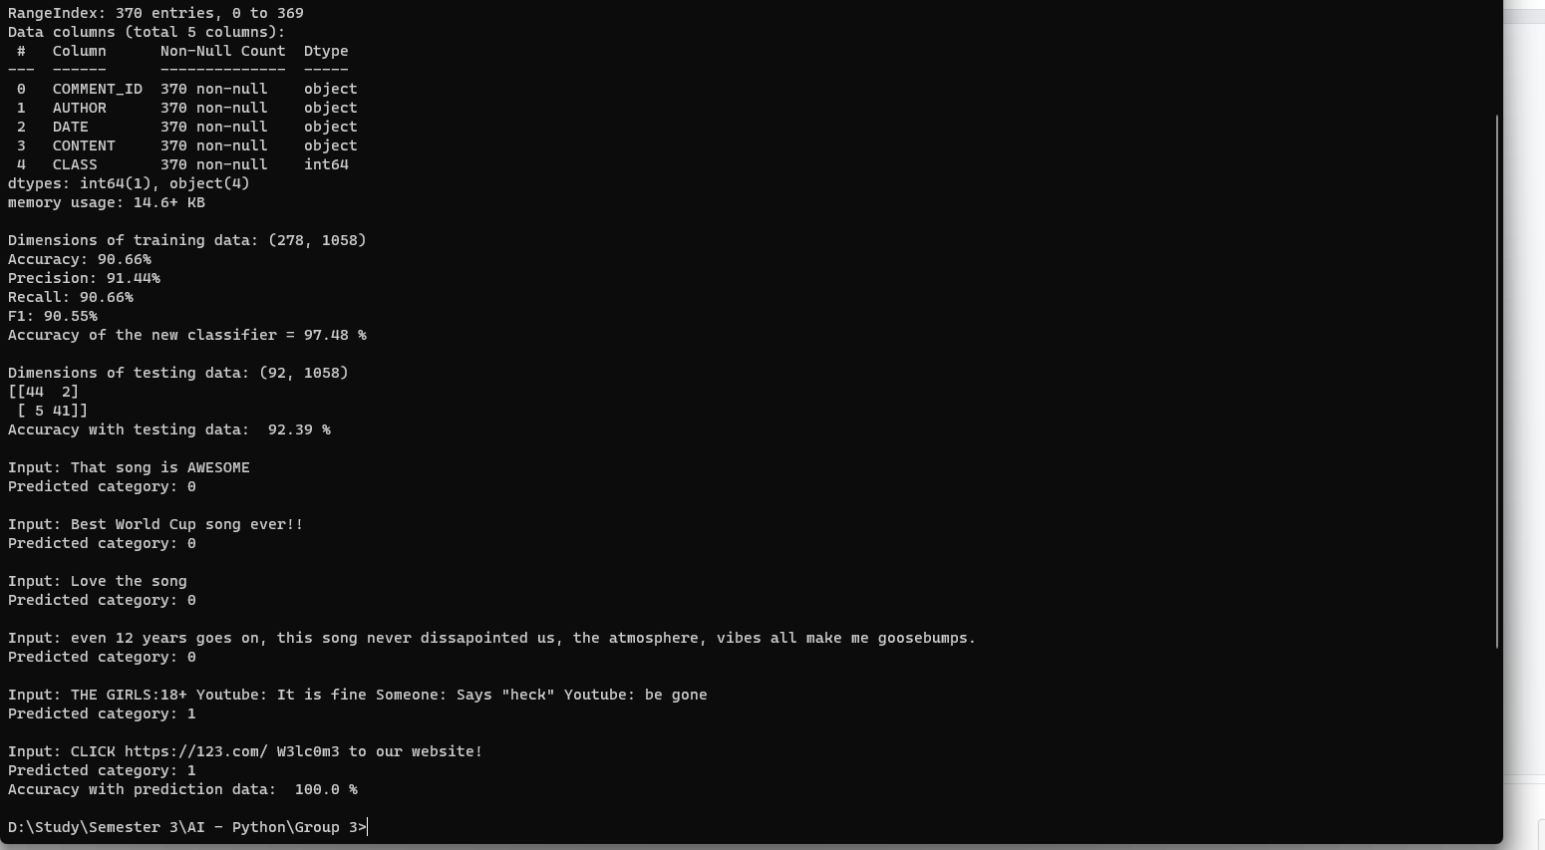
Results of program execution

Slide 7
THANK YOU FOR YOUR ATTENTION <3

